Slide 1
JAVASCRIPT

Slide 2
Scripting Language
scaled down version of programming language
usually interpreted by the computer (eg: web browser )
Examples of script: Perl, VBScript and JavaScript
Processing of a script :
  Client-side : Interpreted by the web browser
  Server-side : Interpreted by the web server

Slide 3
Javascript
It is not Java
Why use script?
  Make a website more interactive and lively
  To validate a form ( check for errors )
  To do arithmetic operations

Slide 4
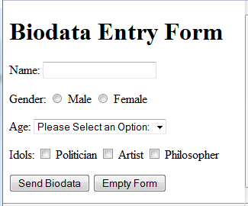
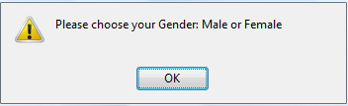
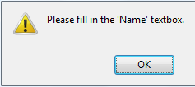
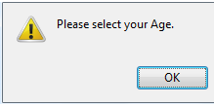
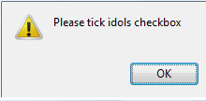
Javascript Example:

Slide 5
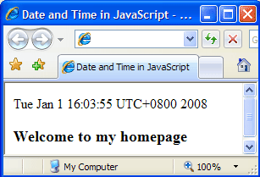
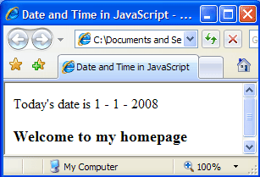
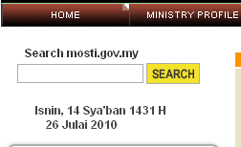

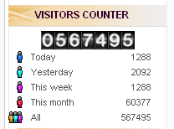
Javascript Example:

Slide 6
Javascript Declaration
<script language= “JavaScript”>
…
</script>
OR
<script type = “text /JavaScript”> …… </script>

Slide 7
Hiding Javascript from Old Browsers
<html>
<body>
<script type="text/javascript">
<!--
document.write("Hello World!");
//-->
</script>
</body>
</html>

Slide 8
Displaying Output
document.write
<script language = “JavaScript”>
document.write(“Hello world”);
</script>

Slide 9
Comment
To write some comments/notes about the codes, use the comment.
It is also useful when you want to disable a particular line of source codes
Single line comment : //
Multiline comment : /* … */

Slide 10
Comment
<script language = “JavaScript”>
// To display greetings to the user
document.write(“Hello world”);
</script>
<script language = “JavaScript”>
/* To display greetings to the user
using document.write */
document.write(“Hello world”);
</script>

Slide 11
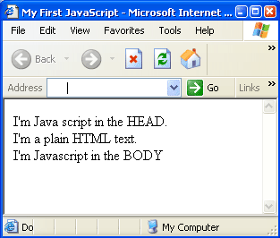
Writing of script
<head> and <body>
<html>
<head>
<title>My First JavaScript</title>
<script language="JavaScript">
document.write("I'm Java script in the HEAD.");
</script>
</head>
<body>
<br>
I'm a plain HTML text.
<br>
<script language="JavaScript">
//To write script in the body
document.write("I'm Javascript in the BODY");
</script>
</body>
</html>

Slide 12
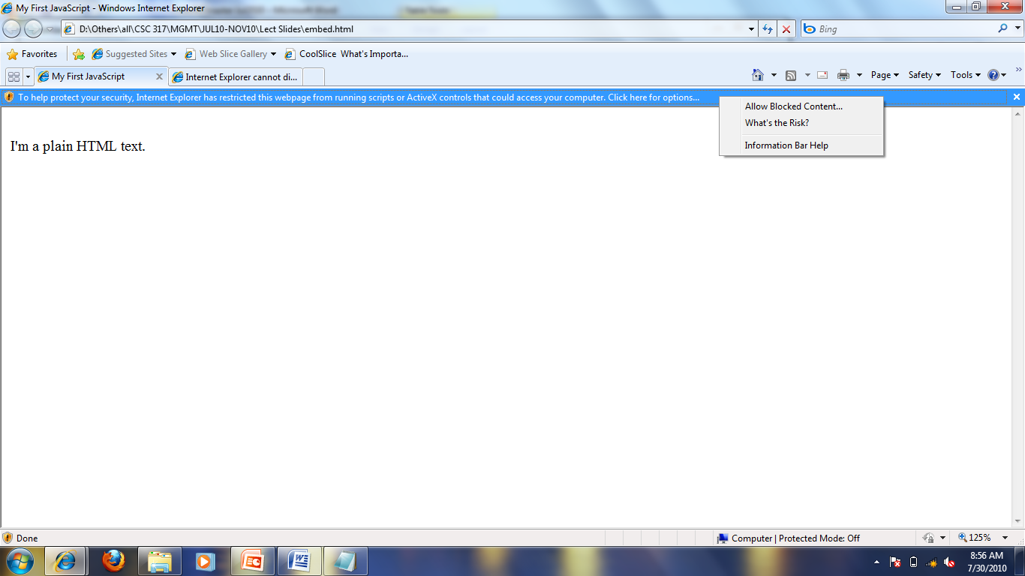
Allowing Scripts
Some settings of a web browser do not allow scripts to be executed. To enable the execution of scripts, left click on the message and choose Allow Blocked Content .
Initially, when the page is loaded into the browser, only plain HTML text is displayed.

Slide 13
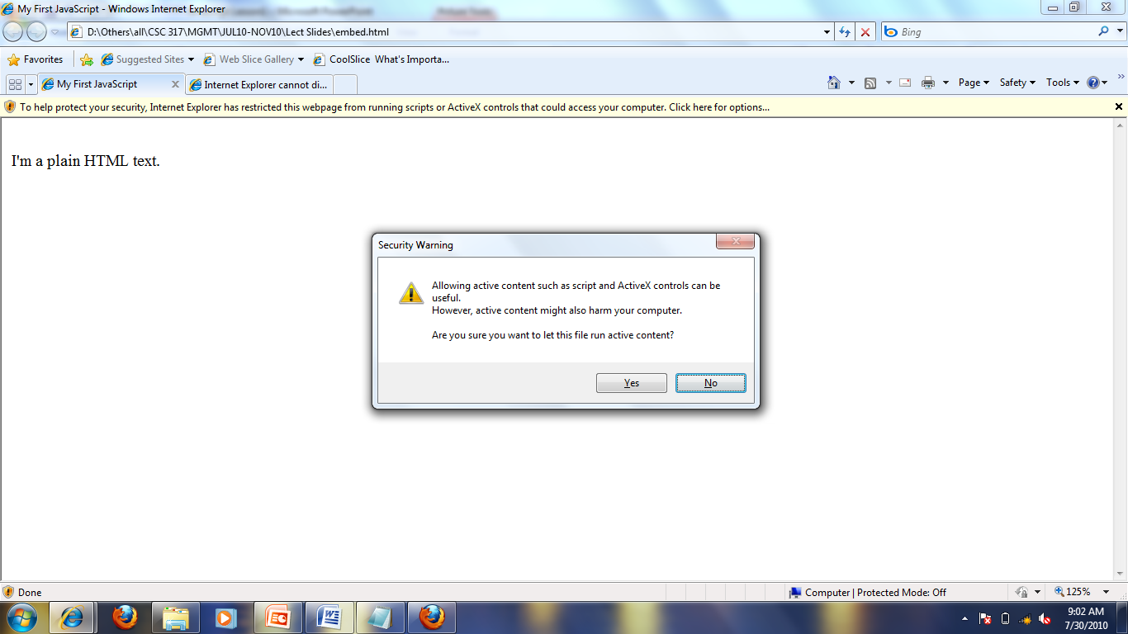
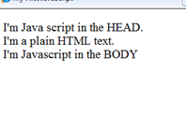
Allowing Scripts
A dialog box will appear, click YES.
Scripts are executed

Slide 14
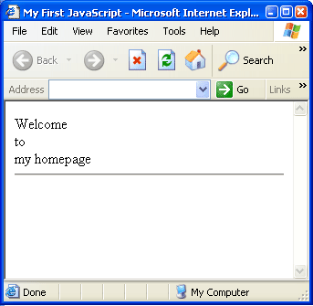
Embedding HTML tags in script
<script language= “JavaScript”>
document.write("Welcome<br>to<br>my homepage<hr>");
</script>

Slide 15
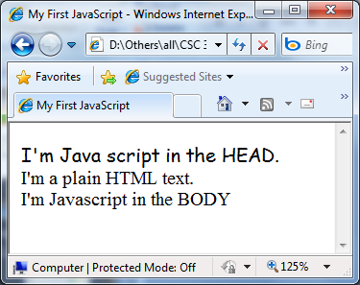
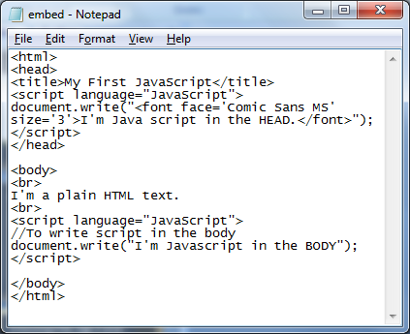
Embedding HTML tags in script

Slide 16
Variables
Variable is a container for the information that you want to store.
The info could be a value, or expression.
Variables can be used to store string, numbers and Boolean(true/false) value.

Slide 17
Variable Declaration
Eg:
  var studentname;
  var studentName;
  var student_name;
Eg:
  var age;
  var Age;
Variable name can be declared in many ways, however its name must be descriptive (i.e represents the kind of data it stores). For example, to store data about student name, you may declare the variable as shown on the left.
Variable declaration must be ended with semicolon (;)

Slide 18
Assigning Value to a Variable
Eg:
var studentname = “Ahmad”; // string
var message=“Hello students”; //string
var age = 21; // number
var price = 34.90; //number
var check = true; // Boolean

Slide 19
Concatenation
Concatenation is an operation to join/ combine string with string OR
string with variable.
Eg:
  “My name is” “Ali”
  document.write(“My name is” + “Ali”);
Eg:
  var studentname = “Ali”;
  “My name is”
  document.write(“My name is” + studentname);

Slide 20
Getting Input From User
prompt
Eg:
  var name = prompt(“Enter your name”);
  var age = prompt(“Please enter your age”);
  var favcolor = prompt(“What is your favourite colour?”);
  var birthdate = prompt(“Bilakah anda dilahirkan?”);

Slide 21
Parsing User Input
parseInt
parseFloat

Slide 22
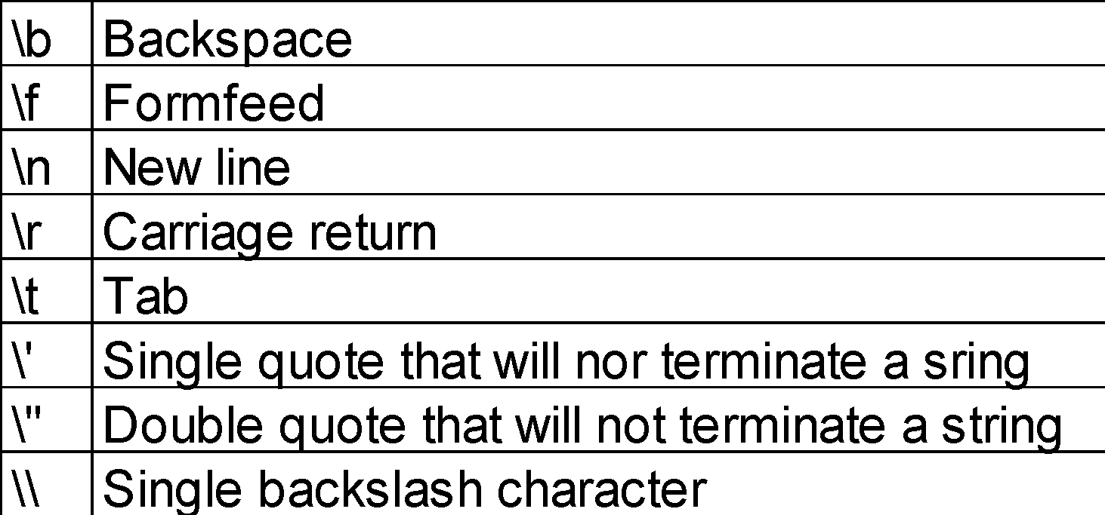
Escape Sequences
when a character in a string is preceded by the backslash character “\” there is a special effect on the character immediately following the backslash

Slide 23
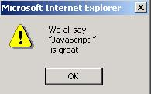
Escape Sequences
Example
alert(“We all say \n\”JavaScript \”\n is great”);
Output

Slide 24
Lesson 2
If else
For loop
While loop
Do while loop
Array
Switch

Slide 25
If else
A conditional statement
For decision making
if (comparison)
{ statements; }
if (comparison)
{ statements; }
else
{ statements; }
if (comparison)
{ statements; }
else if (comparison)
{ statements; }
else
{ statements; }

Slide 26
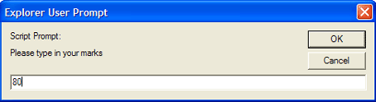
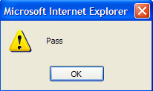
if else example
<script language = “JavaScript”>
var marks;
marks = prompt(“Please type in your marks”);
marks = parseInt(marks);
if (marks>=50)
{
alert(“Pass”);
}
else if(marks < 50)
{
alert(“Fail”);
}
</script>

Slide 27
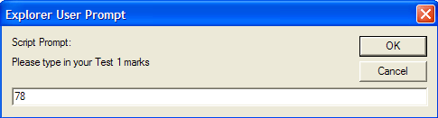
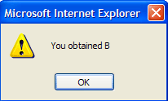
if else example
<script language = "JavaScript">
var marks;
marks = prompt("Please type in your Test 1 marks");
marks = parseInt(marks);
if (marks<0)
{alert("Your marks is out of range");}
else if (marks <50&&marks >0)
{ alert("You obtained E"); }
else if (marks >=50 && marks <60)
{ alert("You obtained D"); }
else if (marks >=60 && marks <70)
{ alert("You obtained C"); }
else if (marks >= 70 && marks <80)
{ alert("You obtained B"); }
else
{ alert ("Congratulations! You are an A student "); </script>

Slide 28
for loop
To do repetition
for (var i= start value; var i< limit; var++)
{
statements;
}

Slide 29
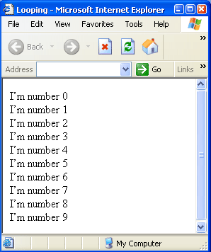
for loop example 1
<html>
<head><title>Looping</title></head>
<body>
<script language=“JavaScript”>
var i;
for (i=0; i<10; i++)
{
document.write("I’m number " +
i + "<br>");
}
</script>
</body>
</html>

Slide 30
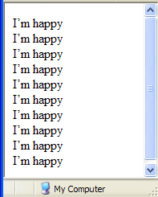
for loop example 2
<html>
<head><title>Looping</title></head>
<body>
<script language=“JavaScript”>
var i;
for (i=0; i<10; i++)
{
document.write( “I’m happy” +
"<br>");
}
</script></body></html>

Slide 31
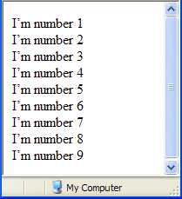
for loop example 3
<html>
<head><title>Looping</title></head>
<body>
<script language=“JavaScript”>
var i;
for (i=1; i<10; i++)
{
document.write("I’m number " +
i + "<br>");
}
</script>
</body>
</html>

Slide 32
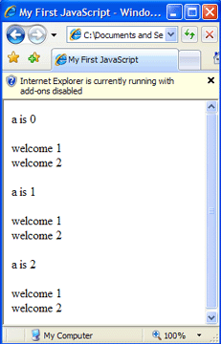
Nested for loop
<html>
<head>
<title>My First JavaScript</title>
</head>
<body>
<script language= "JavaScript">
for (a=0;a<3;a++)
{
document.write("<p>a is " + a + "</p>");
for (b=1;b<3;b++)
{
document.write("welcome " + b + "<br>" );
}
}
</script></body></html>
Explanation:
The outer for loop iterates 3 times (a=0 until a=2) while the inner for loop iterates 2 times only (b=1 until b=2).

Slide 33
While loop
while (condition)
{
statements;
}
statement block;
The statements will continue to be executed as long as the condition is true.

Slide 34
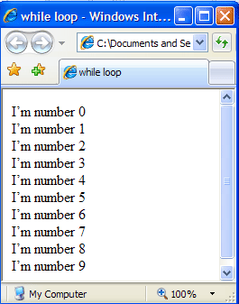
while loop example 1
<html>
<head>
<title>while loop</title>
</head>
<body>
<script language= "JavaScript">
var i=0;
while (i<10)
{
document.write("I’m number " + i + "<br>");
i++;
}
</script></body></html>
Eg 1: This is an example to display the same output like ‘Eg 1 for loop’ using while loop

Slide 35
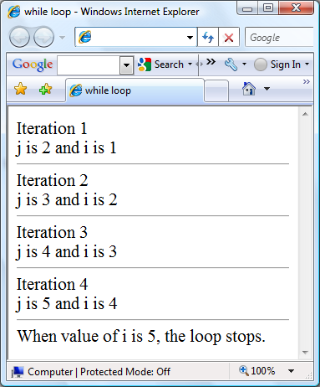
while loop example 2
<html>
<head>
<title>while loop</title>
</head>
<body>
<script language= "JavaScript">
var i=1;
while (i<5)
{
var j=i+1;
document.write("Iteration " + i);
if (j > i)
document.write("<br>j is " + j + " and i is " + i + "<hr>");
i++;
}
document.write(" When value of i is 5, the loop stops. ");
</script></body></html>
Combining if statement inside while loop

Slide 36
do while loop
This is a variation of the while loop. Since the condition is placed at the end of the loop, the statement is executed at least ONCE.
do
{
statements;
}
while (condition);

Slide 37
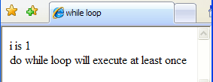
do while example
<html>
<head>
<title>while loop</title>
</head>
<body>
<script language= "JavaScript">
var i=1;
do
{
document.write("i is " + i);
}
while (i>5)
document.write("<br>do while loop will execute
at least once");
</script></body></html>

Slide 38

do while VS while loop
do
{
document.write("i is " + i);
}
while (i>5)
document.write("<br>do while loop will execute at least once");
while (i>5)
{
document.write("i is " + i);
}
document.write("<br>do while loop will execute at least once");

Slide 39
Javascript Array
An array is a variable that can contain multiple values
A variable is given array status using the JS “new” keyword along with the JS “Array()” constructor
Every item in an array has its own index number. Index number starts with 0.

Slide 40
Array Declaration
EXAMPLE 1
  var fruit = new Array();
  fruit[0]= “melon”;
  fruit[1] = “orange”;
  fruit[2] = “rambutan”;
OR
  var fruit = new Array(“melon”,”orange”,”rambutan”);

Slide 41
Array Declaration
EXAMPLE 2
  var mynumber = new Array();
  mynumber[0]= 34;
  mynumber[1] = 150;
  mynumber[2] = 9917;
  mynumber[3] = 1;
OR
  var mynumber = new Array(34,150,9917,1);

Slide 42
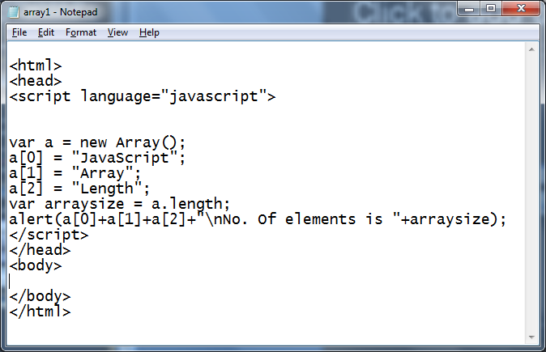
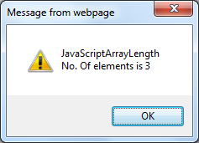
Array – length property
To determine the size of array, use the length property.

Slide 43
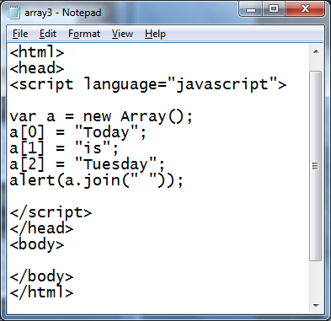
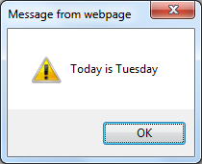
Array – join()
Array join() method will convert all array elements to strings and concatenate them

Slide 44
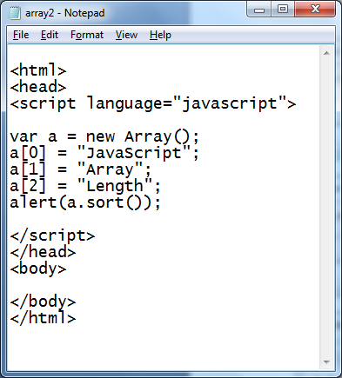
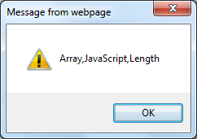
Array – sort()
To sort the item in ascending

Slide 45
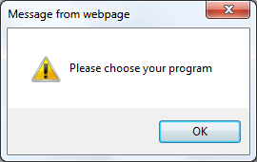
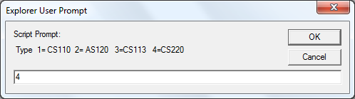
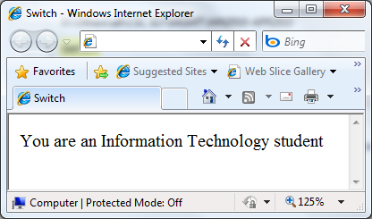
Switch
<script language= "Javascript">
var option;
alert("Please choose your program");
option = prompt(" Type 1= CS110 2= AS120 3=CS113 4=CS220", "");
switch(option)
{
case '1':
document.write("You are a Computer Science student");
break;
case '2':
document.write("You are a Science student");
break;
case '3':
document.write("You are a Quantitative Science student");
break;
case '4':
document.write("You are an Information Technology student");
break;
default:
alert("Error. Please choose an option.");
}
</script>

